Slide 1



Black Codher Bootcamp

Slide 2
UNIT 2 HTML and CSS

Slide 3
SESSION 4
*Preview Time*

Slide 4

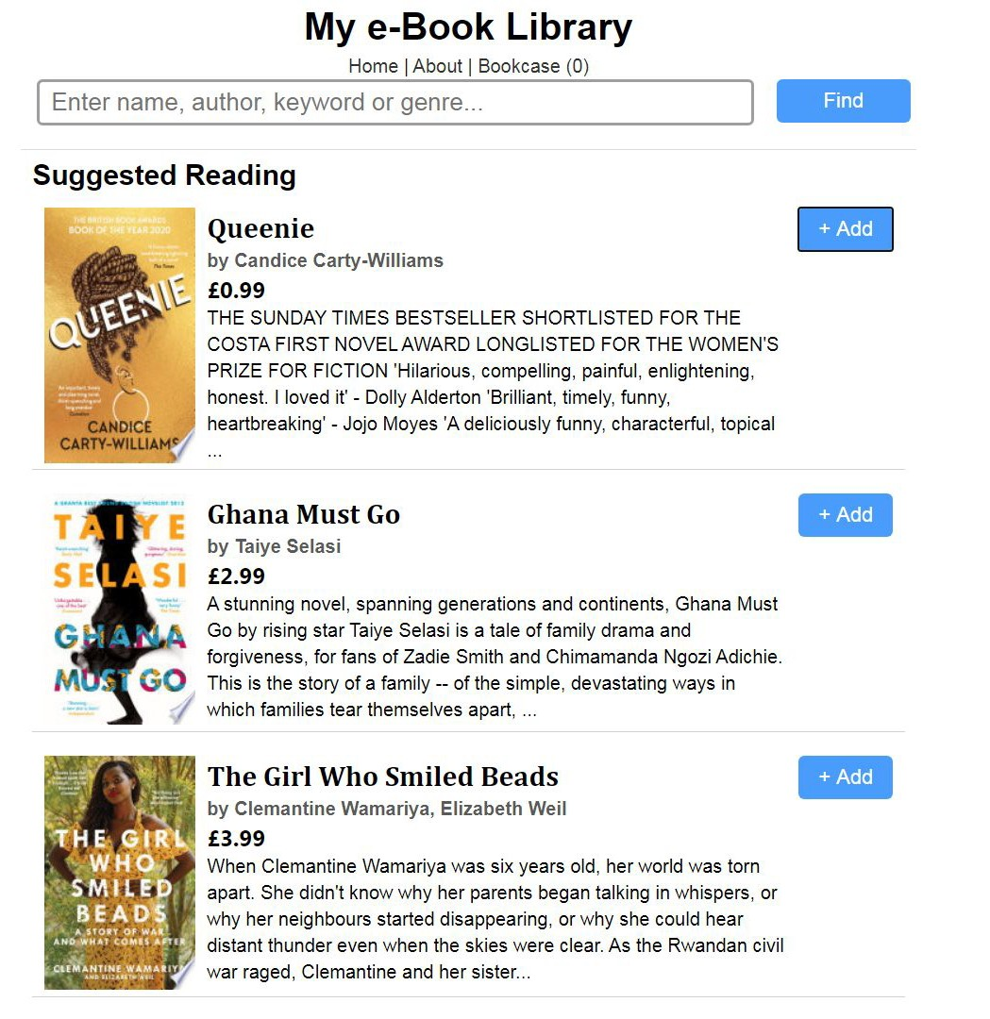
Start building our shop site
Learn how to add Bootstrap
Push our work to GitHub

Slide 5
First let’s check out another code (style) guide, curiously enough - from one of the creators of Bootstrap who now works at GitHub (remember the others ones we’ve talked about are linked there too):https:/ codeguide.co
<!doctype html>
<html lang="en">
<head>
<meta charset="utf-8">
<link href="favicon.png" rel="icon">
<link rel="stylesheet" href="style.css">
<meta name="theme-color" content="#000">
<meta name="description" content="eBook">
...
</head>
<body>
...
<---! Do you recall how to add a button?-->
<button class="addbtn">+ Add</button>
</body>
We’re going to keep these considerations in mind as we move onto our next project, building a bookshop site.
This is going to bridge us over very helpfully into Unit 3. The next (and ﬁnal *sob sob*) sessions of Unit 2 next week will also touch upon transferable concepts to give us a great foundation for JavaScript e.g. variables.
To start off with, let’s take a look at the baseline code we’ll be using to create a main element, headers, sections, articles, summaries, input forms, buttons… Don’t forget to use the meta tag viewport code

Slide 6

<body>
<main id="root">
<section class="container">
<header class="header">
<h1>My e-Book Library</h1>
<nav class="breadcrumb">
<a href="/">Home</a> |
<a href="/about">About</a> |
<a class="bookLink" href="/bookcase">Bookcase (0)</a>
</nav>
</header>
<header class="searchBar">
<form>
<input type="text" placeholder="Enter… " name="search" value="">
<input type="submit" value="Find">
<label>Time for your next good read</label>
</form>
</header>
<section class="list">
<div>
<h2>Suggested Reading</h2>
<div class="book"><img src="..." alt="Queenie">
<article>
<h2 title="Queenie">Queenie</h2>
<p class="author">by Candice Carty-Williams</p>
<p class="price">£0.99</p>
<summary class="description">THE SUNDAY TIMES BESTSELLER ...</summary>
</article>
.header h1,
.header .breadcrumb { text-align: center;
}
.book {
border-bottom: 1px solid rgb(...);
.book .addbtn,
.searchBar input[type=submit] { padding: 8px 10px;
border-radius: 5px;
min-width: 80px; float: right; font-size: 1.1em;
}
.book .addbtn {
background-color: rgb(79, 149, 255);
}

Slide 7
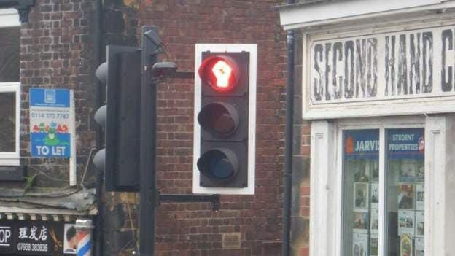
How are you feeling?
RED - I have no idea what you’re talking about
YELLOW - I have some questions but feel like I understand some things
GREEN - I feel comfortable with everything you’ve said

Slide 8




Slide 9
/* Extra small devices (phones, 600px and down) */ @media only screen and (max-width: 600px) {}
/* Small devices (portrait tablets and large phones, 600px and up) */ @media only screen and (min-width: 600px) {}
/* Medium devices (landscape tablets, 768px and up) */ @media only screen and (min-width: 768px) {}
/* Large devices (laptops/desktops, 992px and up) */ @media only screen and (min-width: 992px) {
.container {
width: 50%;
margin: 0 auto;
}
}
/* Extra large devices (large laptops and desktops, 1200px and up) */ @media only screen and (min-width: 1200px) {}

Slide 10
Start ﬁlling in all the remaining parts of the code, especially the CSS. Try out your own ideas ﬁrst then let me know if you’d like to see some exemplars.
Make a list (mentally is ﬁne) of all the different bits of HTML and CSS that you can see in your ﬁles in terms of what you’ve learnt - the winner is whoever get the highest tally in recognition of all that you’ve learnt!
If there’s any part of the code you ﬁnd confusing and or are unsure about, discuss it among yourselves and your volunteer/mentor if one is present. Feel free to use the ask for help feature on Zoom, or make a quick note of it and tell me once we all return to the main room.

Slide 11



Slide 12
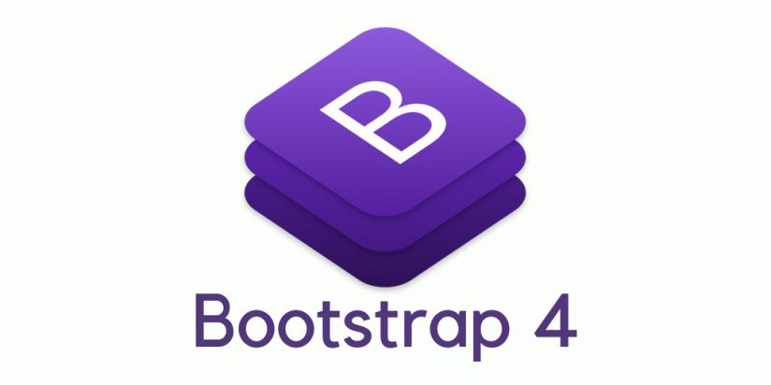

Slide 13

Bootstrap is a free and open source* HTML, CSS, and JavaScript framework focused on responsive and mobile ﬁrst web development which was created by 2 Twitter employees.
Its features make building a website faster and easier by using ﬁxed or ﬂuid grid structures with a default 12 columns and presets. It is comprised of an extensive library of styled frames and widgets that enable us to rapidly create aesthetically pleasing pages with minimal effort - ain’t nobody got time (for that) right?
*aka FOSS

Slide 14
It’s the most popular HTML, CSS, and JavaScript framework: 5th place on GitHub with 144k stars. Certainly must do a great job of avoiding ﬁnicky / fussy bits (!)
Save time by using templates so you complete your projects with more speed
Avoid the frustration that often results when having to style each element Dx
Get nicely designed frame & widget templates that look good from the get go
Responsive web design ready and mobile ﬁrst, again good to go straight away
Near unlimited variety of options which can be further customized with CSS
Easy to use in terms of how straightforward it is to look for a desired aesthetic

Slide 15
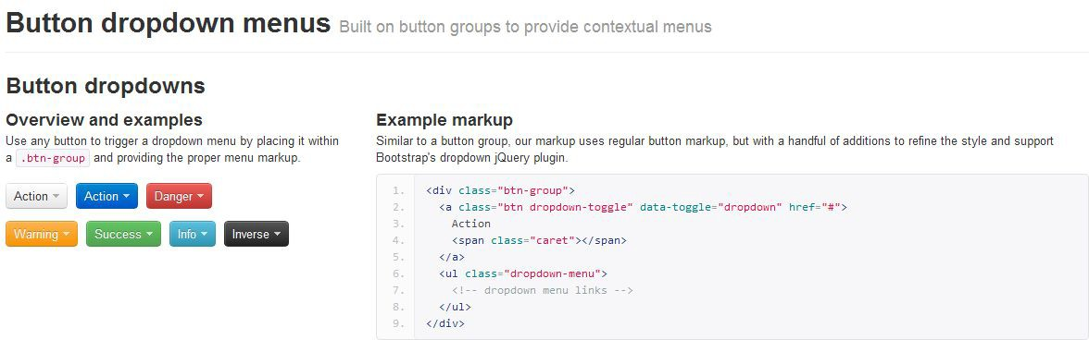
Bootstrap comes in components/options which usually consist of an HTML structure, CSS declarations, and where applicable, some JavaScript. Let’s hop onto the Bootstrap website and take a look for ourselves >>

Slide 16
How are you feeling?
RED - I have no idea what you’re talking about
YELLOW - I have some questions but feel like I understand some things
GREEN - I feel comfortable with everything you’ve said

Slide 17


Slide 18



Slide 19
Ordinarily we’d install Bootstrap using e.g. a package manager. For now, we’ll use their templates and a CDN (content delivery network) which gives us a cached version. No better approach than getting stuck in to learn by doing:
Add the quick start Bootstrap setup code into your HTML
Look on the site for examples you might like to play around with
Copy over code for the relevant element(s) and paste it into your ﬁle(s)
Now have a go at ﬁlling in content and styling bits with further customizations from the library or incorporating it to your work - bring your special CSS touch!

Slide 20
How are you feeling?
RED - I have no idea what you’re talking about
YELLOW - I have some questions but feel like I understand some things
GREEN - I feel comfortable with everything you’ve said

Slide 21



Slide 22
Choose one of the following Bootstrap features to research more how to use:
Layout
Typography
Navigation
Forms
Buttons
You can look things up individually, and then report back to one another. Try to explain to each other the ﬁrst steps of testing out what you’ve just learnt.
If you prefer, you could of course work together in pairs or as one group of 3/4/5.

Slide 23


Slide 24
Insert the rest of the bulk content for individual books to be sold in your shop.
Use this free time as an extra opportunity to catch up on anything you missed , whether that’s session 4 today or previous ones especially portfolio wise.
To wrap up for this week, it’s time to push what we’ve been doing to GitHub. Remember you can of course always check the Command Line and Git slides for a refresher on how to move around in your Terminal / Command Prompt.
Which git command do you need to use to check the status of the repository you initialised to track changes within a folder and its content? How will you add the ﬁles to the staging area? What do we do to make a commit ensuring it has a message? Did you already set up the remote? Will you merge anything?

Slide 25
How are you feeling?
RED - I have no idea what you’re talking about
YELLOW - I have some questions but feel like I understand some things
GREEN - I feel comfortable with everything you’ve said

Slide 26
Reﬁne your portfolio and make sure you’ve pushed to GitHub. Share the link with other people in your group and or anyone else. Ask them to test it and share their thoughts. You can think of this as the ﬁrst steps to code review, plus you may want to check it beforehand in line with those best practice suggestions, DRY/WET principles, and *code) style guides plus standards.
Next, keep customising your bookshop site to make the design more distinctive. Aim to try out different ideas using combinators, media queries, speciﬁcity considerations, CSS Flexbox, and CSS Grids. If you decide to use Bootstrap, make sure to have a separate version without it. This is so that you start from a clearer slate when you start incorporating JavaScript in week 5.)

Slide 27
Any questions?

Slide 28


Woop woop you’ve already ﬁnished Week 3!
Sleep well <3

